Slide 1
Host Firmware Tutorial
Outline of Tutorial and Text

Slide 2

Requirements
VS Code Installed
PlatformIO Extension Installed
GIT Command Line Installed
Still working out DEV requirements. This is a placeholder for now

Slide 3
Outbound Queues
Send sensor data from Notecard to the Cloud

Slide 4
Application Description
Configure Notecard synchronization policy
Acquire sensor measurements
Add sensor measurements to outbound queue
Synchronize data with Notehub

Slide 5
General Workflow Steps
Open the project
Check it will compile and download?
Configure Debug Channel
Configure Serial Connection to Notecard
Configure Notecard Service
Add sensor measurements to queue
Force Sync
Enable periodic sync

Slide 6
Open the project

Slide 7
Does project compile
Let’s make sure the environment works before attempting to start making changes

Slide 8
Configure Debug Channel
main.cpp: setup()
// Configure Serial Debug
delay(2500);
Serial.begin(115200);
NoteSetDebugOutputStream(Serial);
Enables you to view information about communication with Notecard using the Serial Monitor connection with the Arduino board.

Slide 9
Configure Serial Connection to Notecard
main.cpp: setup()
// Configure Note-C Interface to Notecard
NoteInitSerial(Serial1, 9600);
Opens and initializes serial communications channel between Arduino board and Notecard.

Slide 10
Configure Notecard Product ID
main.cpp: setup()
// Configure Product ID
NoteSetProductID("my_default_project_id");
The Product ID is used by the routing infrastructure to associate the Notecard with a project in Notehub.io The Project Id must be populated in order to connect with the cell network.
[OPEN ITEMS] :
Provided to you when you login and use this tutorial?
Provide link on how to get the project ID

Slide 11
Configure Notecard Synchronization Mode
main.cpp: setup()
// Configure Sync
NoteSetUploadMode("minimum", 0 , false);
The sync mode policy determines when Notecard should attempt to connect to the cloud.
The “minimum” option only attempts to sync when there is an explicit request to the Notecard.
More about Notecard sync options
[NOTES] :
This will be changed later in the tutorial
[OPEN ITEMS] :
Link to page that describes Notecard synchronization policies and how they interact with the cloud

Slide 12
Perform Sensor Measurement
main.cpp: loop()
// Perform Sensor Measurement
double temperature, humidity;
getSensorMeasurements(&temperature, &humidity);
Acquire data from temperature and humidity sensors.
This data will be added to an outbound queue to send data to Notehub when synchronization occurs
[NOTES] :
Currently simulates sensor measurements by querying the Notecard temperature and voltage

Slide 13
Add Sensor Measurements to Outbound Queue
main.cpp: loop()
// Add sensor data to outbound queue on Notecard
J* req = NoteNewRequest("note.add");
if (req == NULL)
return;
JAddStringToObject(req, "file", "sensors.qo");
J* body = JCreateObject();
if (body == NULL)
return;
JAddNumberToObject(body, "temperature", temperature);
JAddNumberToObject(body, "humidity", humidity);
JAddItemToObject(req, "body", body);
NoteRequest(req);
Create a JSON request object and add the measured sensor values to the “body” element of the request.
[OPEN ITEMS] :
Should this be broken into smaller chunks? Then it will be easier to explain why each command is called and what it is doing

Slide 14
Force Notecard to Attempt Sync
main.cpp: loop()
// Request Notecard to sync
NoteRequest(NoteNewRequest("service.sync"));
Requests the Notecard to attempt synchronize data with the cloud immediately
More about Notecard sync options and policy
[OPEN ITEMS] :
Explain these functions can be chained together, shortening code for simple requests.

Slide 15
Enable Periodic Notecard Synchronization
main.cpp: setup()
// Configure Sync
NoteSetUploadMode(“continuous", 2 , false);
Configure the Notecard to perform periodic synchronization
The “minutes” argument sets the minimum elapsed time between synchronization attempts if new notes are available in an outbound queue (*.qo –Notefile)
The “connection” mode argument determines if the network connection should be maintained
More about Notecard sync options
[OPEN ITEMS] :
Link to page that describes Notecard synchronization policies and how they interact with the cloud

Slide 16
Inbound Queues
Get command data sent to the Notecard from the cloud

Slide 17
Prerequisites
Notecard Outbound Queue Host Firmware Tutorial

Slide 18
Application Description
Poll the Notecard every 10sec
Check if a new note is available in inbound queue
Set the LED blink period according to value in the new note

Slide 19
General Workflow Steps
Open the project
Check it will compile and download?
Configure Notecard Service
Request Inbound Notes
Process Inbound Notes
Force Sync
Enable periodic sync

Slide 20
Open the project

Slide 21
Does project compile
Let’s make sure the environment works before attempting to start making changes

Slide 22
Configure Notecard Product ID
main.cpp: setup()
// Configure Product ID
NoteSetProductID("my_default_project_id");
The Product ID is used by the routing infrastructure to associate the Notecard with a project in Notehub.io The Project Id must be populated in order to connect with the cell network.
[OPEN ITEMS] :
Provided to you when you login and use this tutorial?
Provide link on how to get the project ID

Slide 23
Configure Notecard Synchronization Mode
main.cpp: setup()
// Configure Sync
int syncPeriodMinutes = 1;
NoteSetUploadMode("continuous", syncPeriodMinutes, false);
The sync mode policy determines when Notecard should attempt to connect to the cloud.
The “continuous” option maintains a network connection. The sync period is the minimum time the Notecard checks to see if a sync is necessary.
More about Notecard sync options
[NOTES] :
This will be changed later in the tutorial
[OPEN ITEMS] :
Link to page that describes Notecard synchronization policies and how they interact with the cloud

Slide 24
Build request for inbound Note queue
main.cpp: loop()
// Build request for note in queue
J* req = NoteNewRequest("note.get");
JAddStringToObject(req, "file", "led-command.qi");
JAddBoolToObject(req, "delete", true);
Create a JSON request object that asks Notecard for notes available in a queue
“file” – which inbound queue to check
“delete”:true – delete the note once it is read.

Slide 25
Perform Request
main.cpp: loop()
// Request note from Notecard
J* rsp = NoteRequestResponse(req);
if(rsp == NULL)
return;
Send request to Notecard and await a response.
If the response is null, an allocation error occurred. In this case, just exit the loop() function.

Slide 26
Check Response for Error
main.cpp: loop()
//Check for error in the response
if (NoteResponseError(rsp)) {
// If the Response contains an error,
// assume there are no more notes in the queue
NoteDeleteResponse(rsp);
return;
}
If the response contains an error code, we assume the error is: there are no more notes available. And exit the loop() function.
The NoteDeleteResponse function is called to clean up memory allocated to the response object.

Slide 27
Get the Note “body”
main.cpp: loop()
// Get body of the note
J* body = JGetObject(rsp, "body");
if (body == NULL){
NoteDeleteResponse(rsp);
return;
}
The Note body contains the information we want to extract.
If the body is null, there was an allocation error. Delete the response object and exit the loop() function.

Slide 28
Extract LED Blink Period value and process it.
main.cpp: loop()
// Extract value of "blinkPeriod" from body
blinkPeriodMs = JGetInt(body, "blinkPeriod");
// Display value on debug stream
NotePrintf("Blink Period: %dms\n\n", blinkPeriodMs);
// Delete Response Object
NoteDeleteResponse(rsp);
Extract the value of the LED blink period from the Note body using the JGetInt() function.
For now, print the value to the debug stream using NotePrintf() and delete the response object.
We don’t exit the loop() function here, because there may be more Notes in the inbound queue that we want to process.

Slide 29
Send LED Blink Period from Notehub using cURL
 | Description | Example
<app_uid> | App UID | app:d8edc5cc-c7d7-48ef-aeda-7147b884111a
<device_uid> | Device UID | imei:865284040125662
Open system command prompt
Enter cURL command as shown on the right
Replace <app_id> and <device_id> with values for your specific Notehub.io project and Notecard device.
More info
Linux
curl -L 'http://api.notefile.net/req?project="<app_uid>"&device="<device_uid>"' -d '{"req":"note.add","file":"led-command.qi","body":{"blinkPeriod":500}}'
Windows*
curl -L "http://api.notefile.net/req?project=\"<app_uid>\"&device=\"<device_uid>\"" -d "{\"req\":\"note.add\",\"file\":\"led-command.qi\",\"body\":{\"blinkPeriod\":500}}"
* Escape double quotes contained within the command on Windows.
i.e: \"

Slide 30
Ensure blinkPeriod is available in body.
main.cpp: loop()
// Extract value of "blinkPeriod" from body
if (JIsPresent(body, "blinkPeriod")){
blinkPeriodMs = JGetInt(body, "blinkPeriod");
// Display value on debug stream
NotePrintf("Blink Period: %dms\n\n", blinkPeriodMs);
}
// Delete Response Object
NoteDeleteResponse(rsp);
If the field “blinkPeriod” is not found in the Note body, the JGetInt() will return 0.
Handle this exception more gracefully using the JIsPresent() function to determine if the “blinkPeriod” field is available before assigning the value of blinkPeriodMs

Slide 31
Add QI-File to Notehub
Using Notehub API to send data from cloud to a device

Slide 32
Requirements
cURL
or
Postman

Slide 33
General Workflow Steps
Get App UID
Get Device UID
Using Notehub
Using notecard CLI
Send QI-File request to Notehub
Using cURL
Using POSTMAN

Slide 34
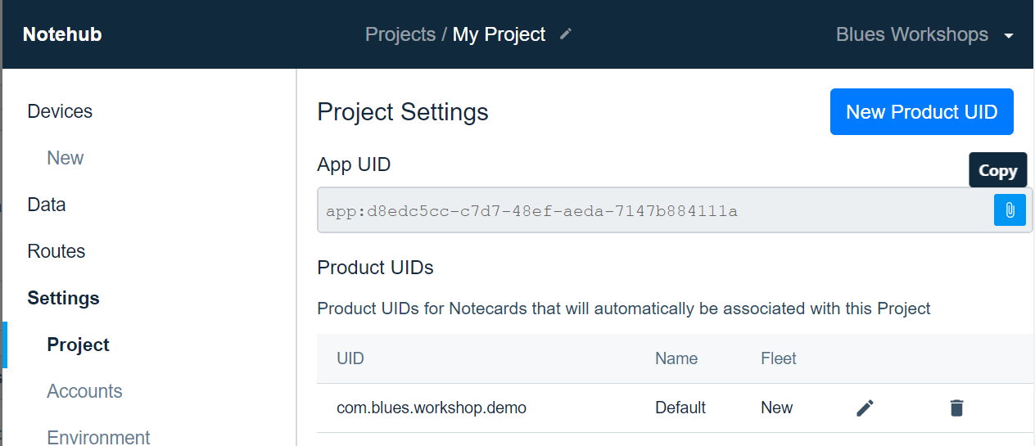


Get App UID
Navigate to https://notehub.io/projects
Select a Project
e.g.: My Project
Click “Project” under “Settings” header on navigation tree
Hover mouse over right side of App UID field
Click to copy App UID to clipboard
4
3

Slide 35
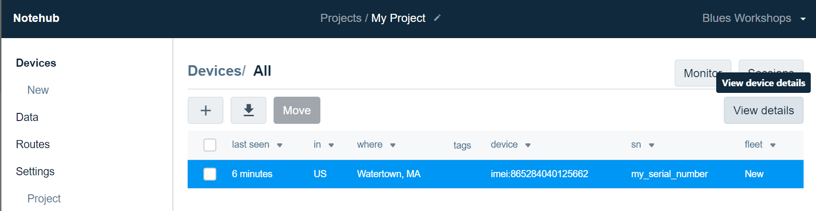
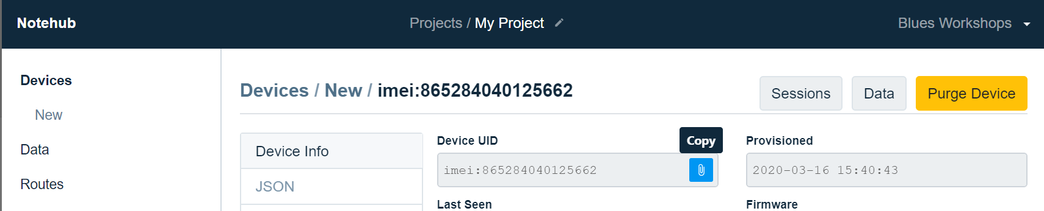
Get Device UID using Notehub
3
Navigate to https://notehub.io/projects
Select a Project
e.g.: My Project
Click “Device” in navigation tree
Select the row in the Devices table
Click View Details button
Hover mouse over right side of Device UID field
Click to copy App UID to clipboard
5
4
6

Slide 36
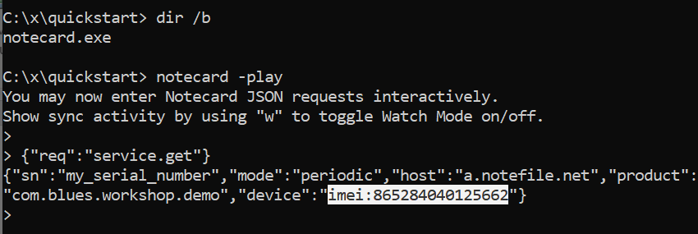
Get Device UID using notecard CLI
4
Connect Notecarrier with Notecard via USB to your computer
Open system command prompt
Change current directory to location that has notecard executable
Enter notecard -play
Enter {"req":"service.get"}
Copy the value of the "device" field
e.g.: imei:865284040125662
5
6

Slide 37
Create QI-file on Notehub using cURL
 | Description | Example
<app_uid> | App UID | app:d8edc5cc-c7d7-48ef-aeda-7147b884111a
<device_uid> | Device UID | imei:865284040125662
<notefile.qi> | Name of Notefile syncing from Notehub to Notecard | my-inbound.qi
<body_json> | JSON data that is sent to Notecard | {"key1":"value1"}
Open system command prompt
Enter cURL command as shown on the right
* Replace <xxxx> in the command with your specific, app uid, device uid, notefile name, and JSON body.
Linux
curl -L 'http://api.notefile.net/req?project="<app_uid>"&device="<device_uid>"' -d '{"req":"note.add","file":"<notefile.qi>","body":<body_json>}'
Windows*
curl -L "http://api.notefile.net/req?project=\"<app_uid>\"&device=\"<device_uid>\"" -d "{\"req\":\"note.add\",\"file\":\"<notefile.qi>\",\"body\":<body_json>}"
* Escape double quotes contained within the command on Windows.
i.e: \"

Slide 38

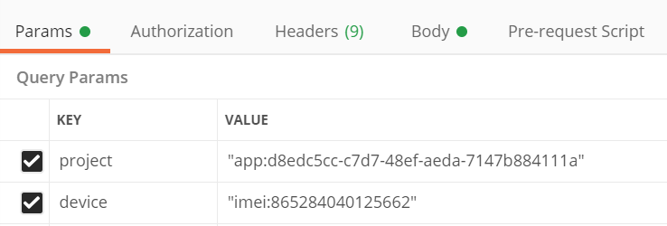
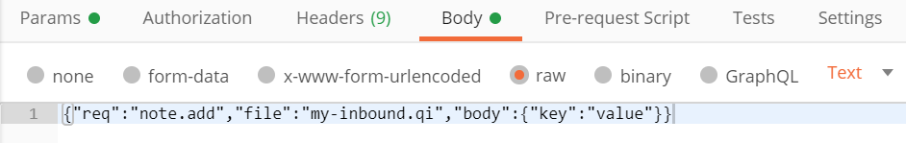
Create QI-file on Notehub using Postman
 | Description | Example
<app_uid> | App UID | app:d8edc5cc-c7d7-48ef-aeda-7147b884111a
<device_uid> | Device UID | imei:865284040125662
<notefile.qi> | Name of Notefile syncing from Notehub to Notecard | my-inbound.qi
<body_json> | JSON data that is sent to Notecard | {"key1":"value1"}
Open Postman and create a new query
Enter the following in the URL field
http://api.notefile.net/req
Select the Params tab and enter the following key/value pairs
4. Select the Body tab, and set the input type to “raw”
5. Enter the following JSON string
{"req":"note.add","file":"<notefile.qi>","body":<body_json>}
6. Click SEND button
2
project | "<app_uid>"
device | "<device_uid>"
3
4
5

Slide 39
Sync Policy Briefs
Mode | Sync Policy | Network Connection | Notes
continuous | Periodically check if sync is required | If not connected to network, establish a connection and keep it open | Good tool for product development. Network syncs take less time if connection to network is maintained. Syncs require less data usage. Not a good option for low power applications.
periodic | Periodically check if sync is required | Establish network connection, sync, disconnect from network | Good for production deployment and low power applications. Connection only established when needed. Can set a minimum and maximum elapsed time between connections
minimum | When explicitly requested | Establish network connection, sync, disconnect from network | Default configuration. Minimizes power usage by only connecting to the network when explicitly requested. Not a good option if notecards need to download data from the cloud within a specified time window.

Slide 40
Simplified Sync Policy on Notecard
Start
Manual sync request?
Minimum Sync Period Elapsed
New Notes in outboundNotefiles?
Maximum Sync Period Elapsed
Attempt Sync

